Slide 1
Experimentally assessing the plasticity and evolution of cyanobacterial salinity tolerance
Slides available as PDF or PPTX at: https://bit.ly/39Dk1Kc
Jennifer Reeve, Boswell Wing, Christopher Greidanus, Maxwell Pashayan, Anya Sukiennicki, Paige Campbell
University of Colorado Boulder
AbSciCon 2022 – Recent Advances, Development and New Challenges in Understanding Early Life

Slide 2
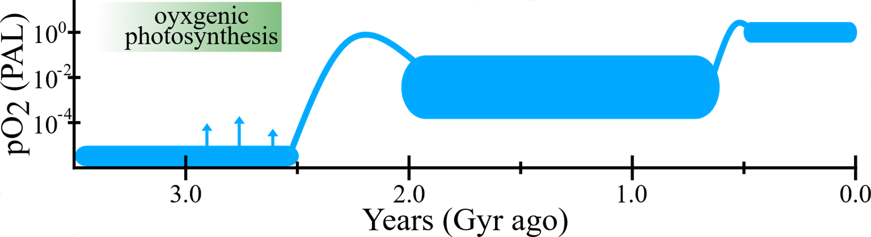
Cyanobacteria and the Great Oxidation Event (GOE)

Slide 3
There are competing hypotheses about the timing of the origin of oxygenic photosynthesis and the GOE
?

Slide 4
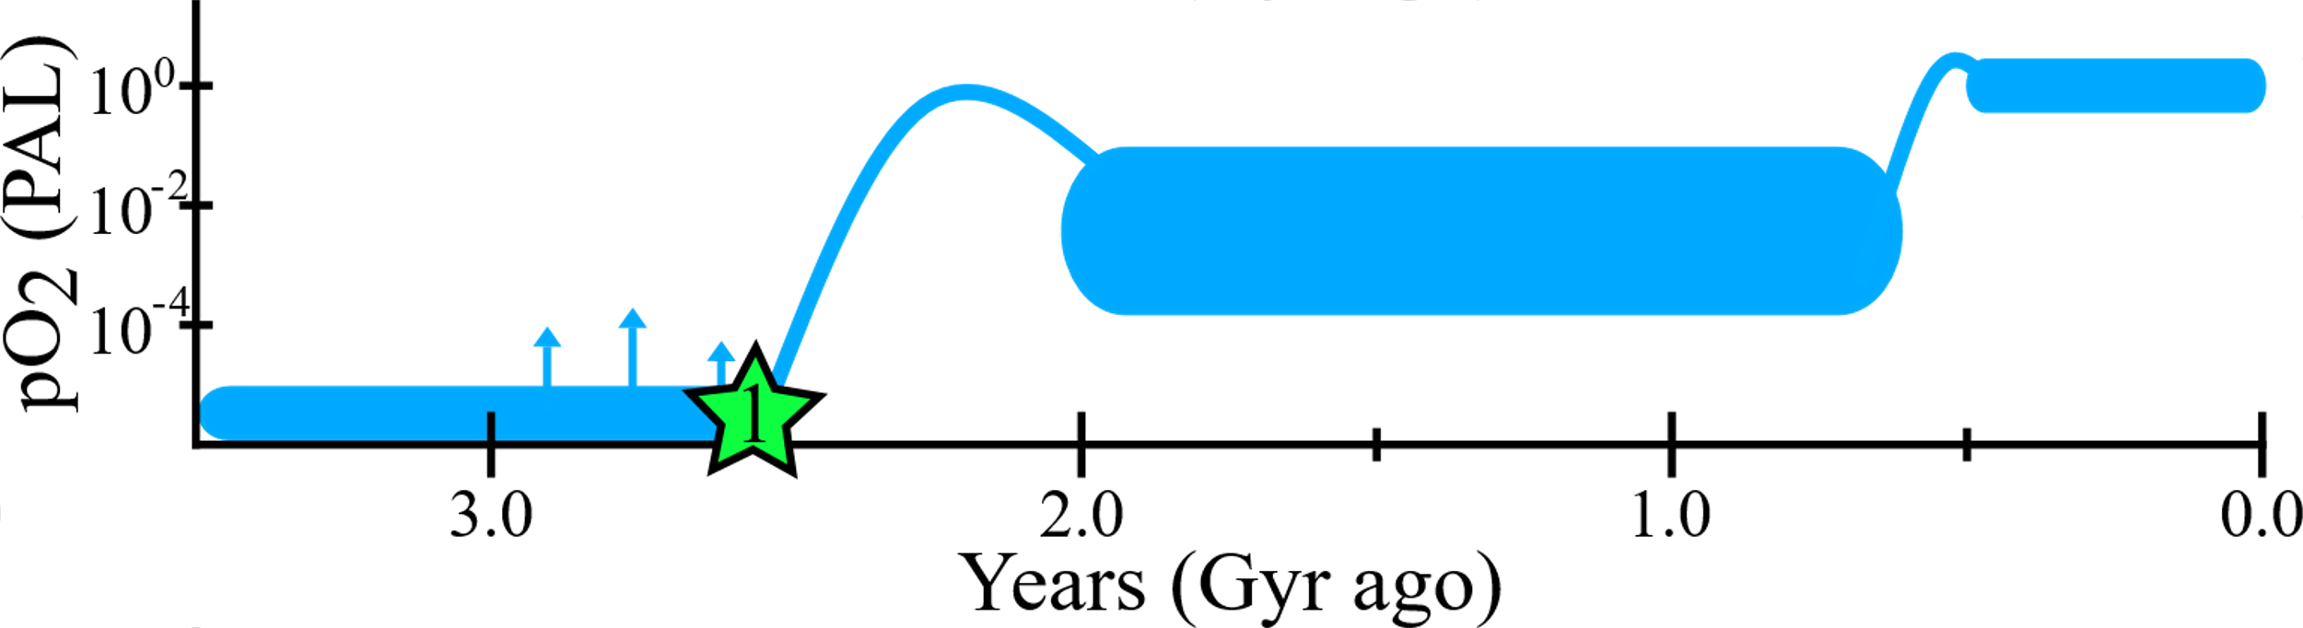
Hypothesis 1: Oxygenic photosynthesis evolved just prior the GOE

Slide 5

Hypothesis 2: Oxygenic photosynthesis evolved well before the GOE but was ecologically restricted

Slide 6
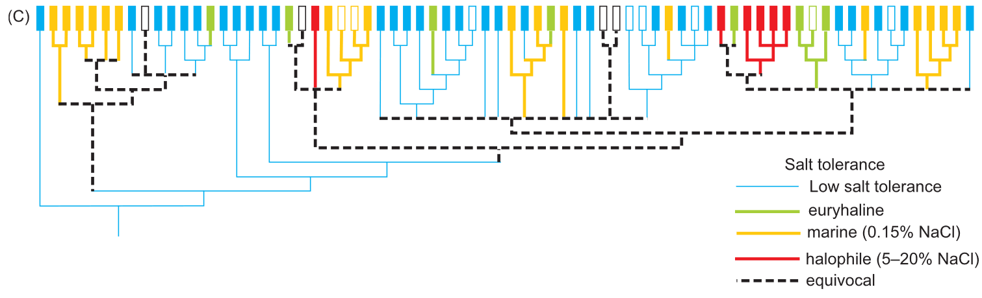
The transition from terrestrial to marine environments has been posited as a major constraint
Sánchez-Baracaldo et. al. 2005
Notes:
When I started my PhD I thought I was going to assess early cyanobacterial evolution to several important environmental parameters, but instead I discovered there was more than enough to investigate about just one. Salinity tolerance is often included in discussion of a delay between the origin of oxygenic photosynthesis and the GOE. This has largely been assessed through ancestral state reconstructions. But as I started to develop experiments to assess cyanobacterial evolution to changes in salinity, I realized there are two major underlying assumptions about extant/modern cyanobacteria that these reconstructions rely on.

Slide 7
Research questions
Does habitat predict salinity tolerance?
Is salinity tolerance discrete?

Slide 8
Research questions
Does habitat predict salinity tolerance?
Is salinity tolerance discrete?

Slide 9
We surveyed the literature to develop a database of cyanobacterial responses to changes in salinity
Notes:
To assess this, I started looking through the literature, and quickly realized that while there is a rich history of investigating cyanobacterial responses to salinity tolerance, there did not seem to be any synthesis of the phylum-wide responses.

Slide 10
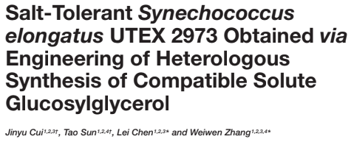
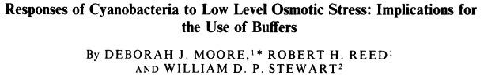
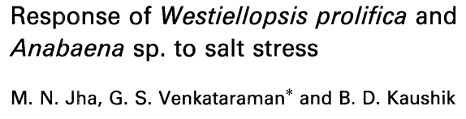
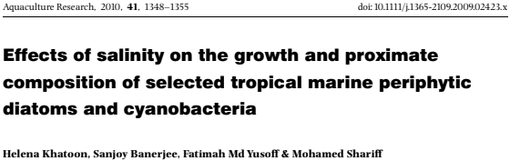
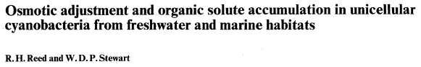
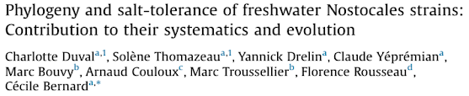
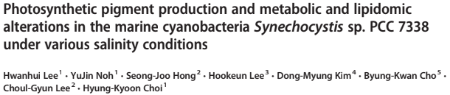
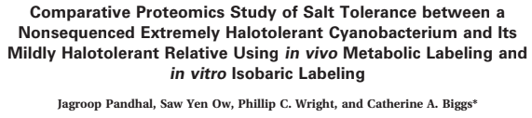
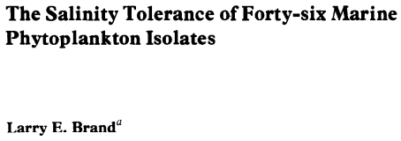
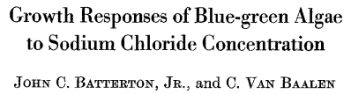
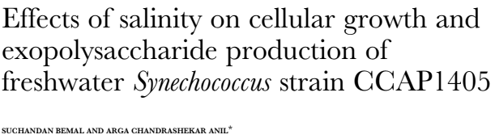
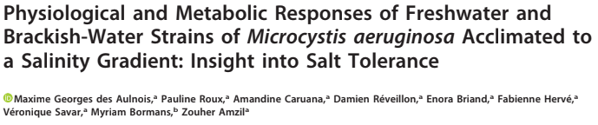
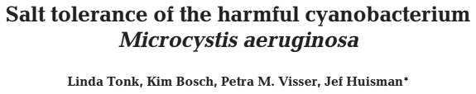
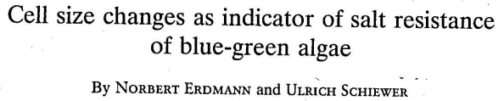
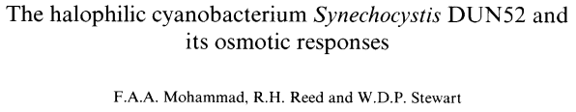
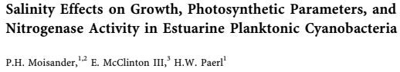
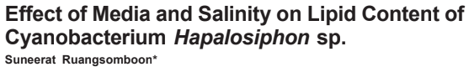
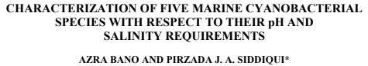
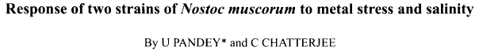
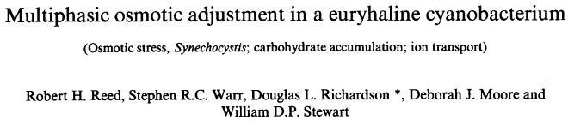
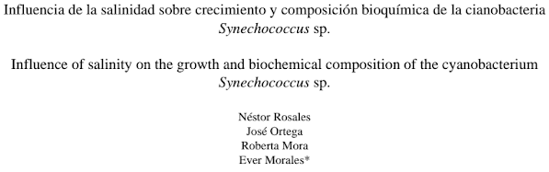
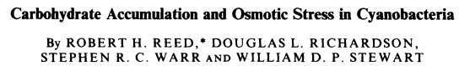
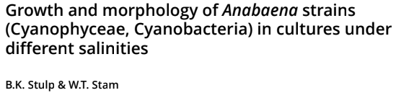
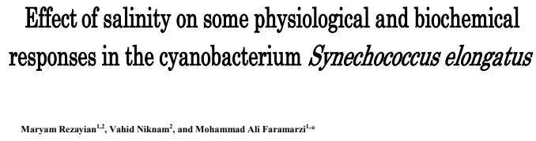
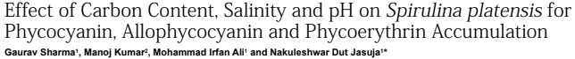
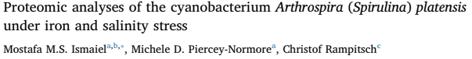
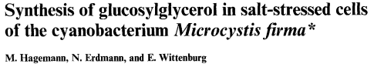
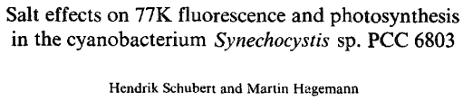
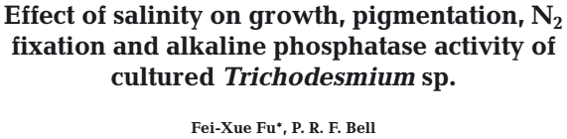
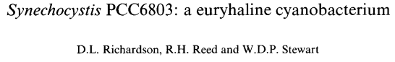
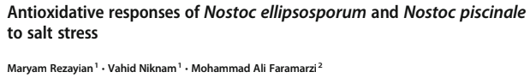
We surveyed the literature to develop a database of cyanobacterial responses to changes in salinity
Papers | Species | Growth rates | Salinity range
> 20 | > 75 | > 1000 | 0 – 230 ppt
Notes:
So with the help of several undergraduate researchers we collected data from the literature and conducted experiments on additional strains in the lab, to be able to assess salinity tolerance across the cyanobacterial phylum. So I'm going to walk you through some high level results we've discovered, and give you a glimpse of where this synthesis is taking us.

Slide 11
Does habitat predict salinity tolerance?
Notes:
First we can look at the optimal salinity for each strain, ie the salinity at which the maximum growth rate was observed. On the x-axis we have the salinity at which this maximum growth rate occurred, and on the y-axis we have 4 categories habitats from which the cyanobacterial strains were isolated: terrestrial, which includes soil, bio-crust, and freshwater strains, brackish, marine, and hypersaline. There is a vertical line denoting marine salinity at 35 ppt. And interestingly, nearly all of the strains we have data for have optimal salinities below marine salinity.

Slide 12
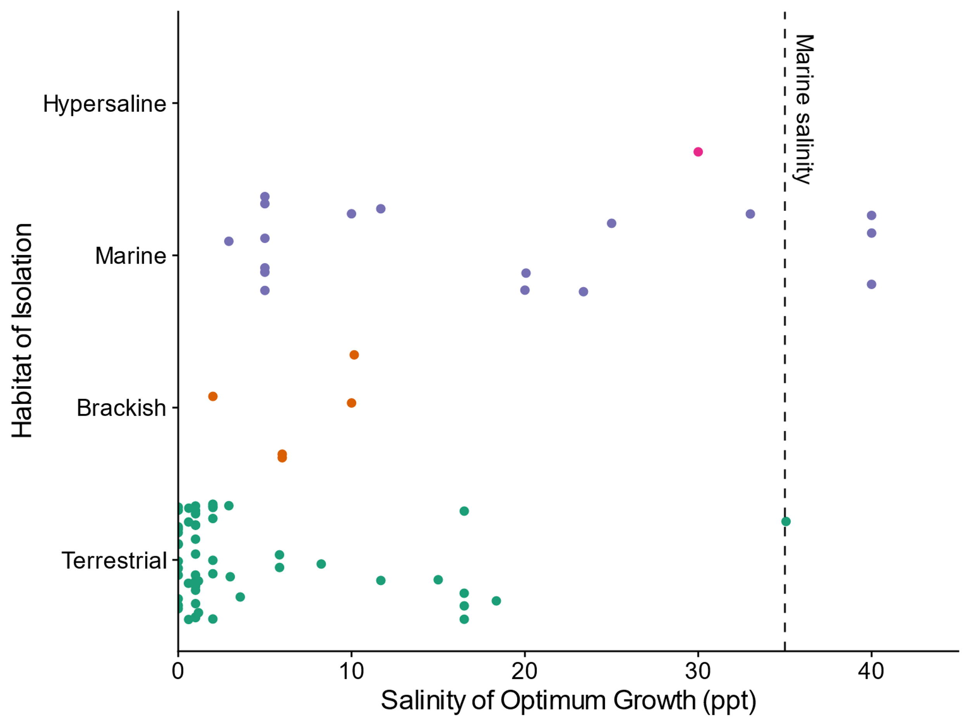
Does habitat predict salinity tolerance?
Notes:
First we can look at the optimal salinity for each strain, ie the salinity at which the maximum growth rate was observed. On the x-axis we have the salinity at which this maximum growth rate occurred, and on the y-axis we have 4 categories habitats from which the cyanobacterial strains were isolated: terrestrial, which includes soil, bio-crust, and freshwater strains, brackish, marine, and hypersaline. There is a vertical line denoting marine salinity at 35 ppt. And interestingly, nearly all of the strains we have data for have optimal salinities below marine salinity.

Slide 13
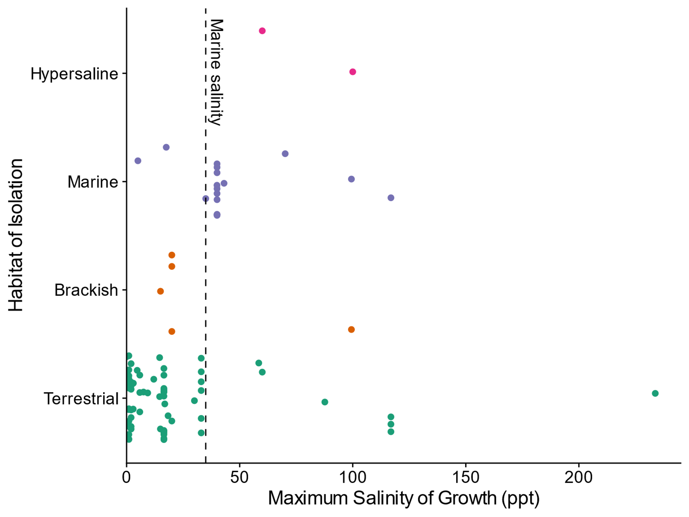
Does habitat predict salinity tolerance?
Notes:
On the other hand, if we look at the maximum salinity at which growth was observed, a considerable number of strains can be found growing above 35 ppt. It is worth noting that the scale on the x-axis has changed from a maximum around 50 ppt to well over 200 ppt. Interestingly, several terrestrial strains have maximum salinities above that of the hypersaline strains for which we have data. And several marine strains have maximum salinities below those typically associated with marine environments.

Slide 14
Is salinity tolerance discrete?
Notes:
This consideration of the data so far has still been relatively discrete, at which salinities does a strain grow? But we can look at how well strains grow at different salinities as well through reaction norms. This is an example reaction norm from a strain we tested in our lab, on the x-axis we again have salinity, and on the y-axis we have the growth rate. We can see that the strain does fairly similarly across most of the range from fresh to marine salinities, but as the salinity approaches 35 ppt, the growth rate decreases and becomes more variable.

Slide 15
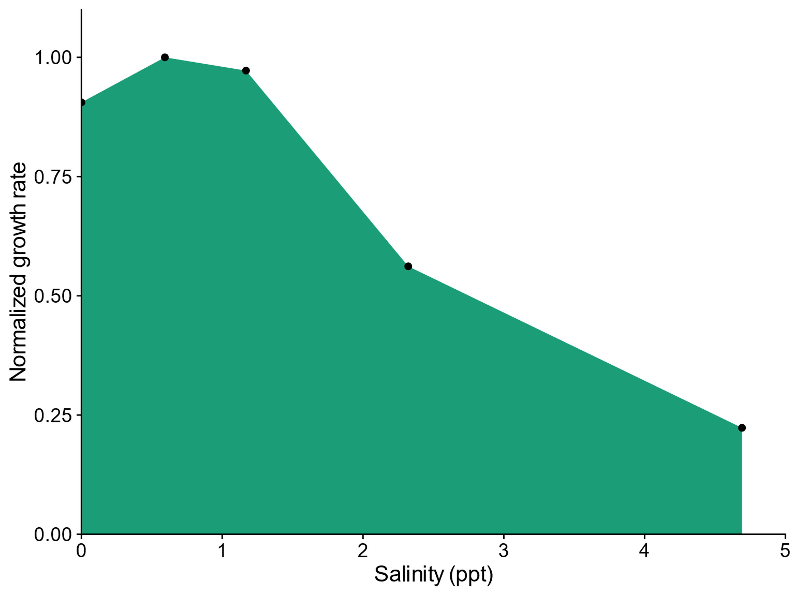
Is salinity tolerance discrete?
Notes:
This consideration of the data so far has still been relatively discrete, at which salinities does a strain grow? But we can look at how well strains grow at different salinities as well through reaction norms. This is an example reaction norm from a strain we tested in our lab, on the x-axis we again have salinity, and on the y-axis we have the growth rate. We can see that the strain does fairly similarly across most of the range from fresh to marine salinities, but as the salinity approaches 35 ppt, the growth rate decreases and becomes more variable.

Slide 16
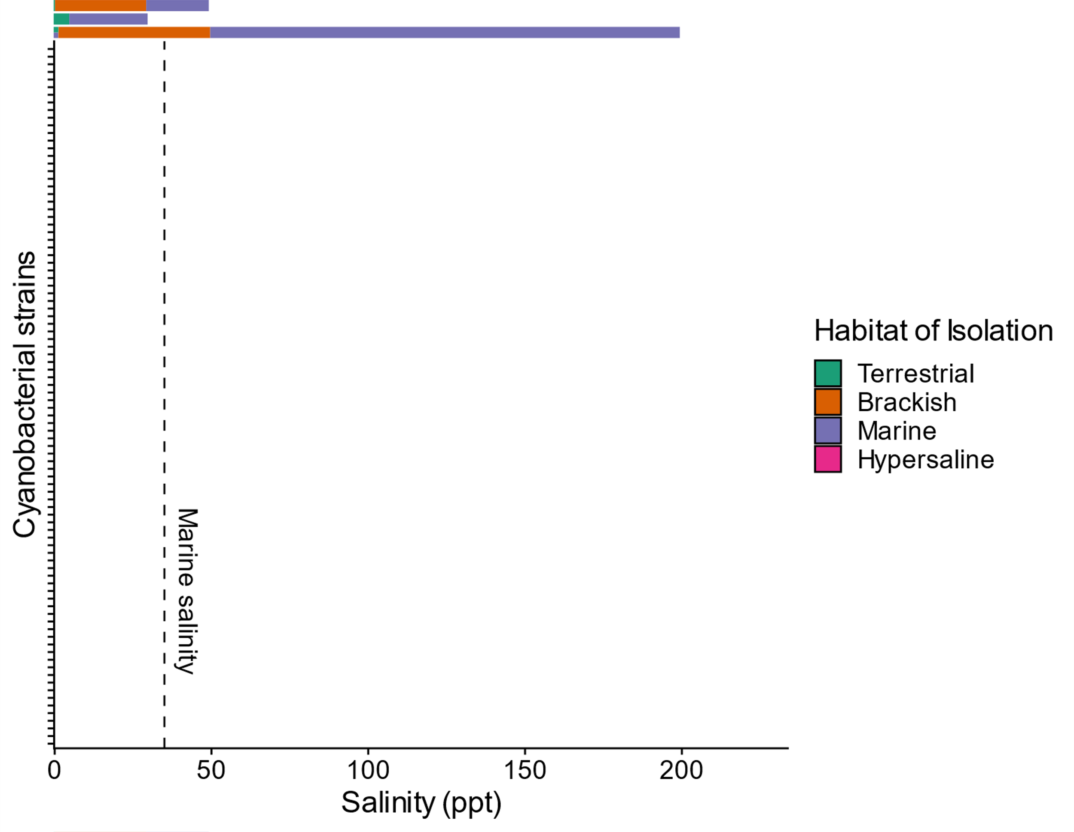
Is salinity tolerance discrete?
1. Sánchez-Baracaldo et. al. 2005
2. Uyeda et. al. 2016
3. Sánchez-Baracaldo et. al. 2017
Notes:
On the other hand, if we look at the maximum salinity at which growth was observed, a considerable number of strains can be found growing above 35 ppt. It is worth noting that the scale on the x-axis has changed from a maximum around 50 ppt to well over 200 ppt. Interestingly, several terrestrial strains have maximum salinities above that of the hypersaline strains for which we have data. And several marine strains have maximum salinities below those typically associated with marine environments.

Slide 17
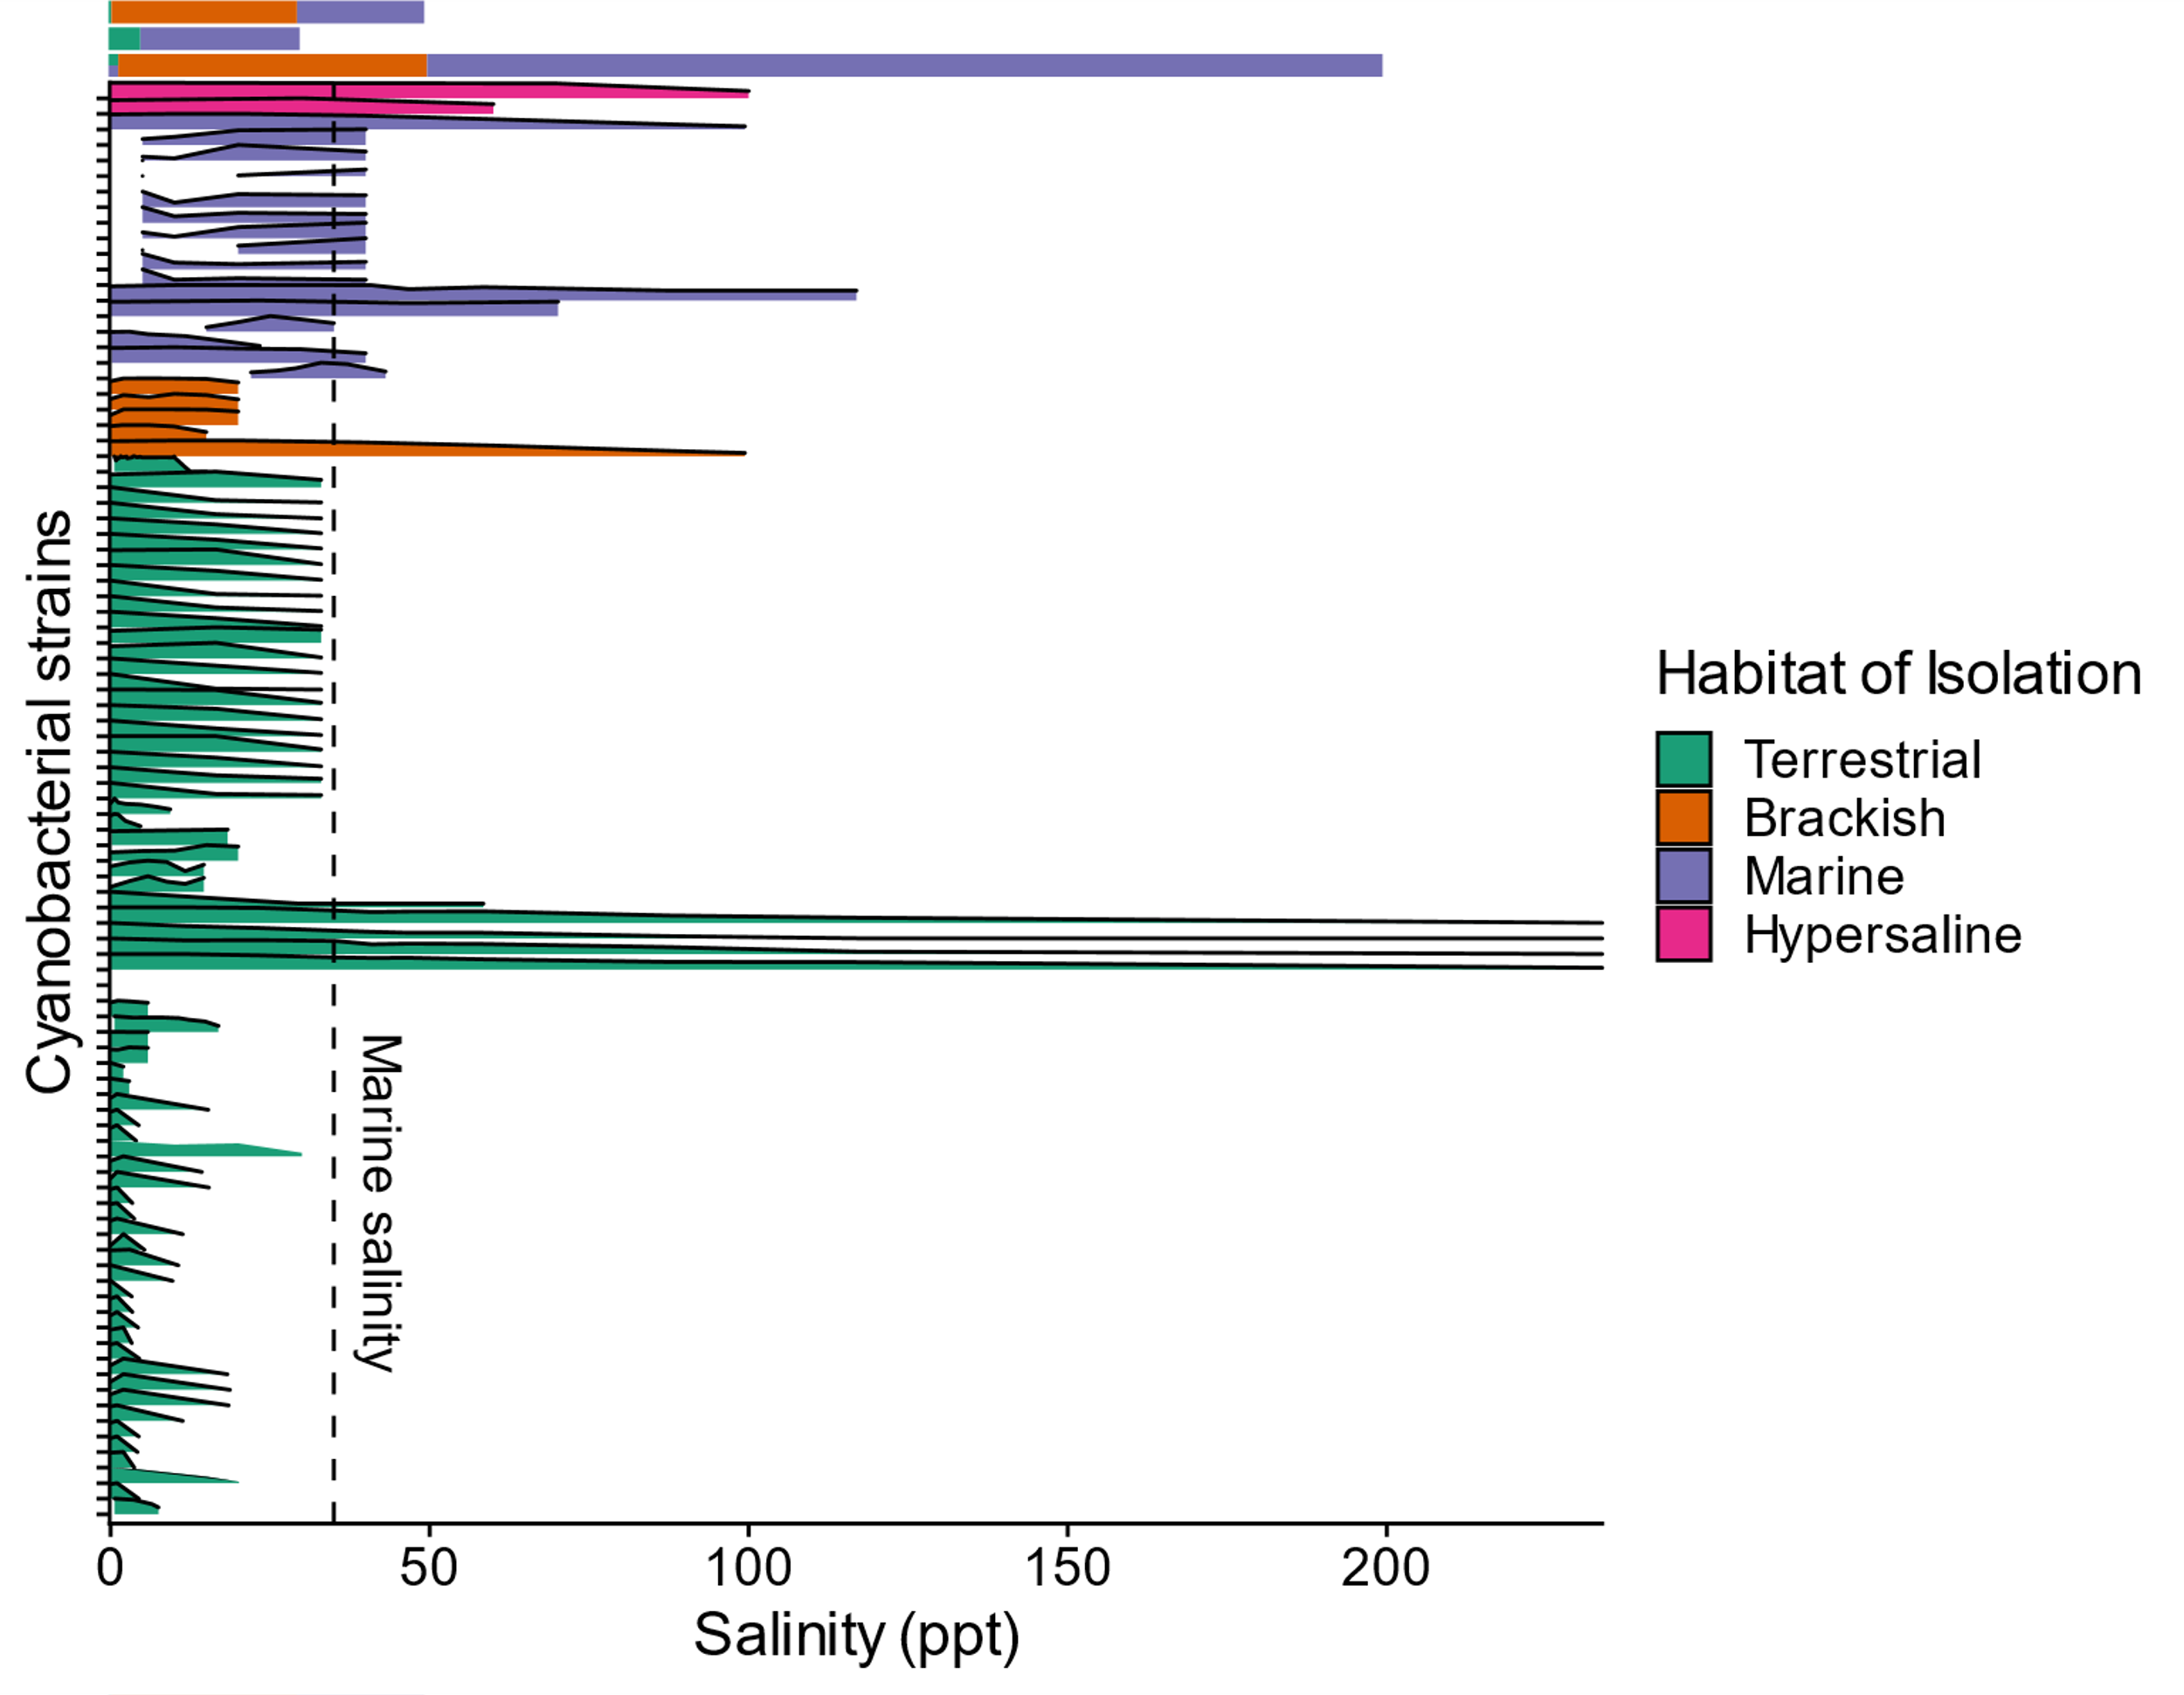
Is salinity tolerance discrete?
1. Sánchez-Baracaldo et. al. 2005
2. Uyeda et. al. 2016
3. Sánchez-Baracaldo et. al. 2017
Notes:
On the other hand, if we look at the maximum salinity at which growth was observed, a considerable number of strains can be found growing above 35 ppt. It is worth noting that the scale on the x-axis has changed from a maximum around 50 ppt to well over 200 ppt. Interestingly, several terrestrial strains have maximum salinities above that of the hypersaline strains for which we have data. And several marine strains have maximum salinities below those typically associated with marine environments.

Slide 18
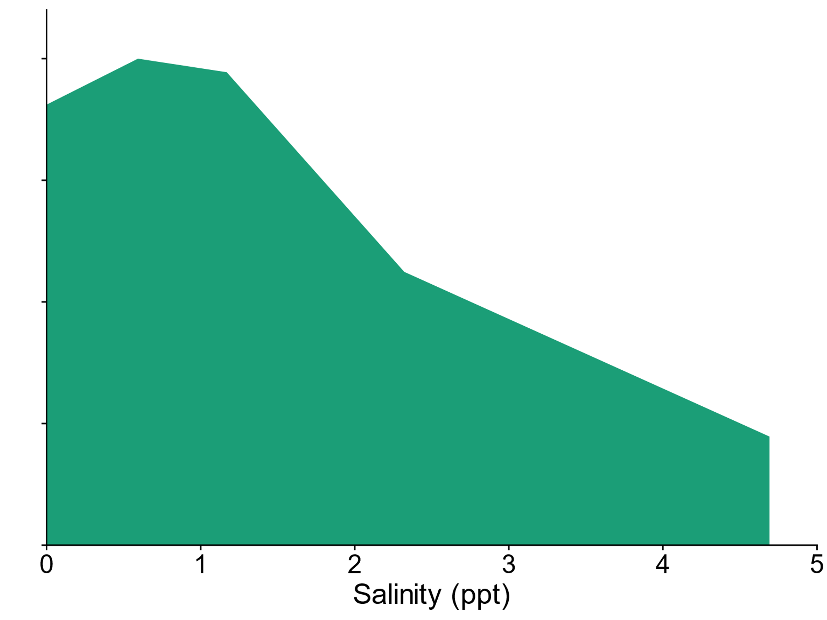
Is salinity tolerance discrete?
1. Sánchez-Baracaldo et. al. 2005
2. Uyeda et. al. 2016
3. Sánchez-Baracaldo et. al. 2017
Expected terrestrial reaction norm
Notes:
On the other hand, if we look at the maximum salinity at which growth was observed, a considerable number of strains can be found growing above 35 ppt. It is worth noting that the scale on the x-axis has changed from a maximum around 50 ppt to well over 200 ppt. Interestingly, several terrestrial strains have maximum salinities above that of the hypersaline strains for which we have data. And several marine strains have maximum salinities below those typically associated with marine environments.

Slide 19
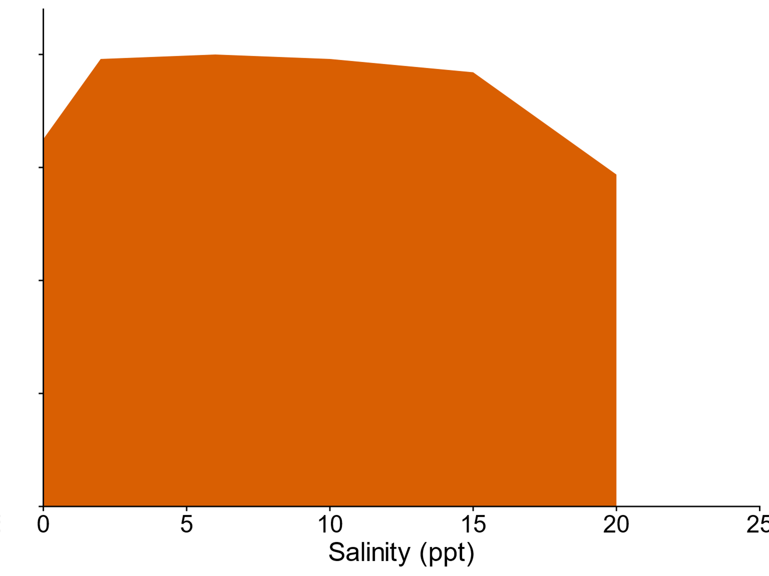
Is salinity tolerance discrete?
1. Sánchez-Baracaldo et. al. 2005
2. Uyeda et. al. 2016
3. Sánchez-Baracaldo et. al. 2017
Expected brackish reaction norm
Notes:
On the other hand, if we look at the maximum salinity at which growth was observed, a considerable number of strains can be found growing above 35 ppt. It is worth noting that the scale on the x-axis has changed from a maximum around 50 ppt to well over 200 ppt. Interestingly, several terrestrial strains have maximum salinities above that of the hypersaline strains for which we have data. And several marine strains have maximum salinities below those typically associated with marine environments.

Slide 20
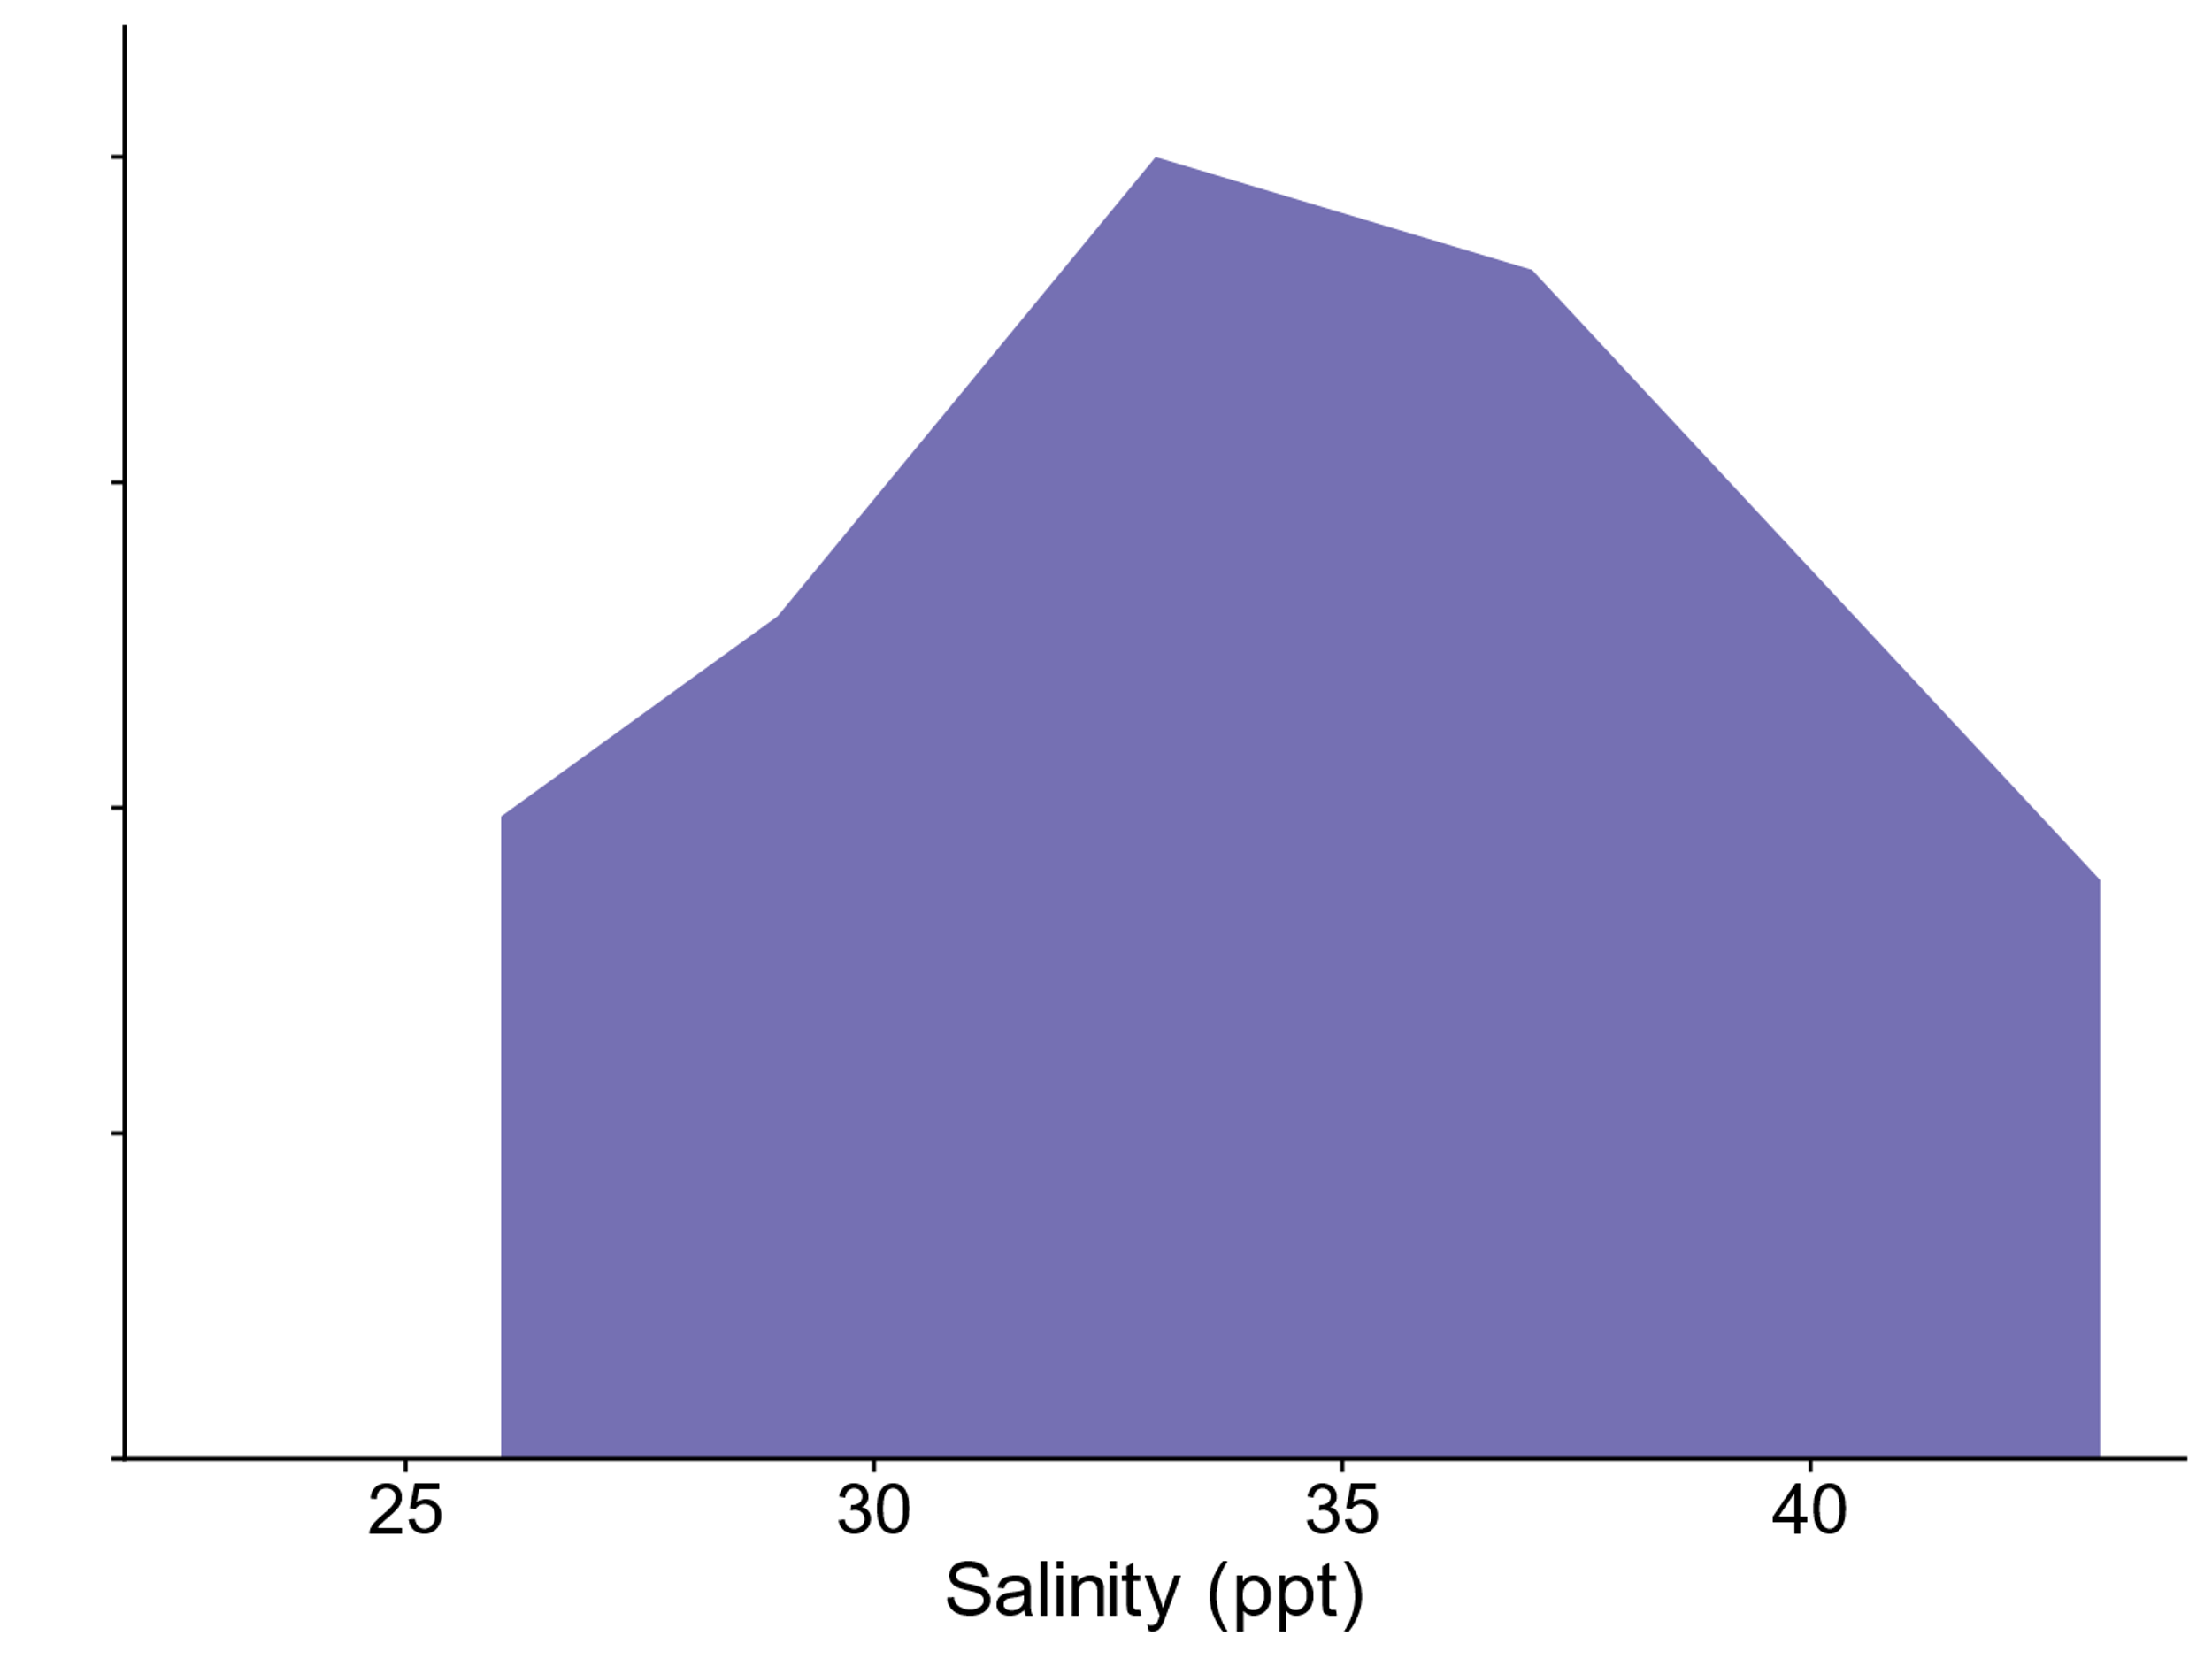
Is salinity tolerance discrete?
1. Sánchez-Baracaldo et. al. 2005
2. Uyeda et. al. 2016
3. Sánchez-Baracaldo et. al. 2017
Expected marine reaction norm
Notes:
On the other hand, if we look at the maximum salinity at which growth was observed, a considerable number of strains can be found growing above 35 ppt. It is worth noting that the scale on the x-axis has changed from a maximum around 50 ppt to well over 200 ppt. Interestingly, several terrestrial strains have maximum salinities above that of the hypersaline strains for which we have data. And several marine strains have maximum salinities below those typically associated with marine environments.

Slide 21
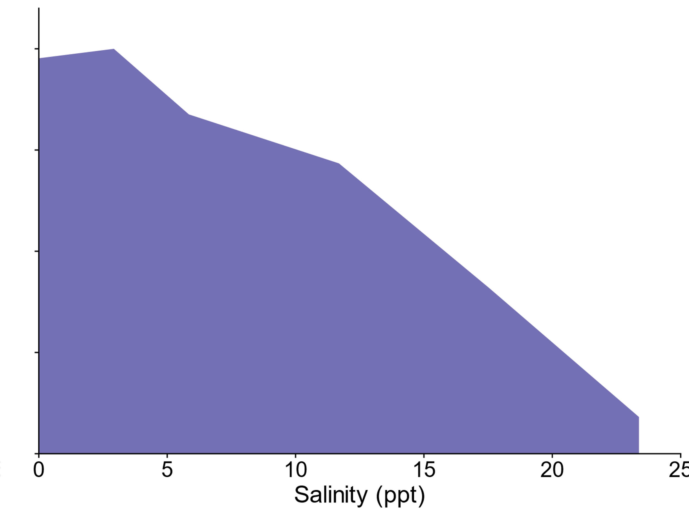
Is salinity tolerance discrete?
1. Sánchez-Baracaldo et. al. 2005
2. Uyeda et. al. 2016
3. Sánchez-Baracaldo et. al. 2017
Low salt tolerance marine reaction norm
Notes:
On the other hand, if we look at the maximum salinity at which growth was observed, a considerable number of strains can be found growing above 35 ppt. It is worth noting that the scale on the x-axis has changed from a maximum around 50 ppt to well over 200 ppt. Interestingly, several terrestrial strains have maximum salinities above that of the hypersaline strains for which we have data. And several marine strains have maximum salinities below those typically associated with marine environments.

Slide 22
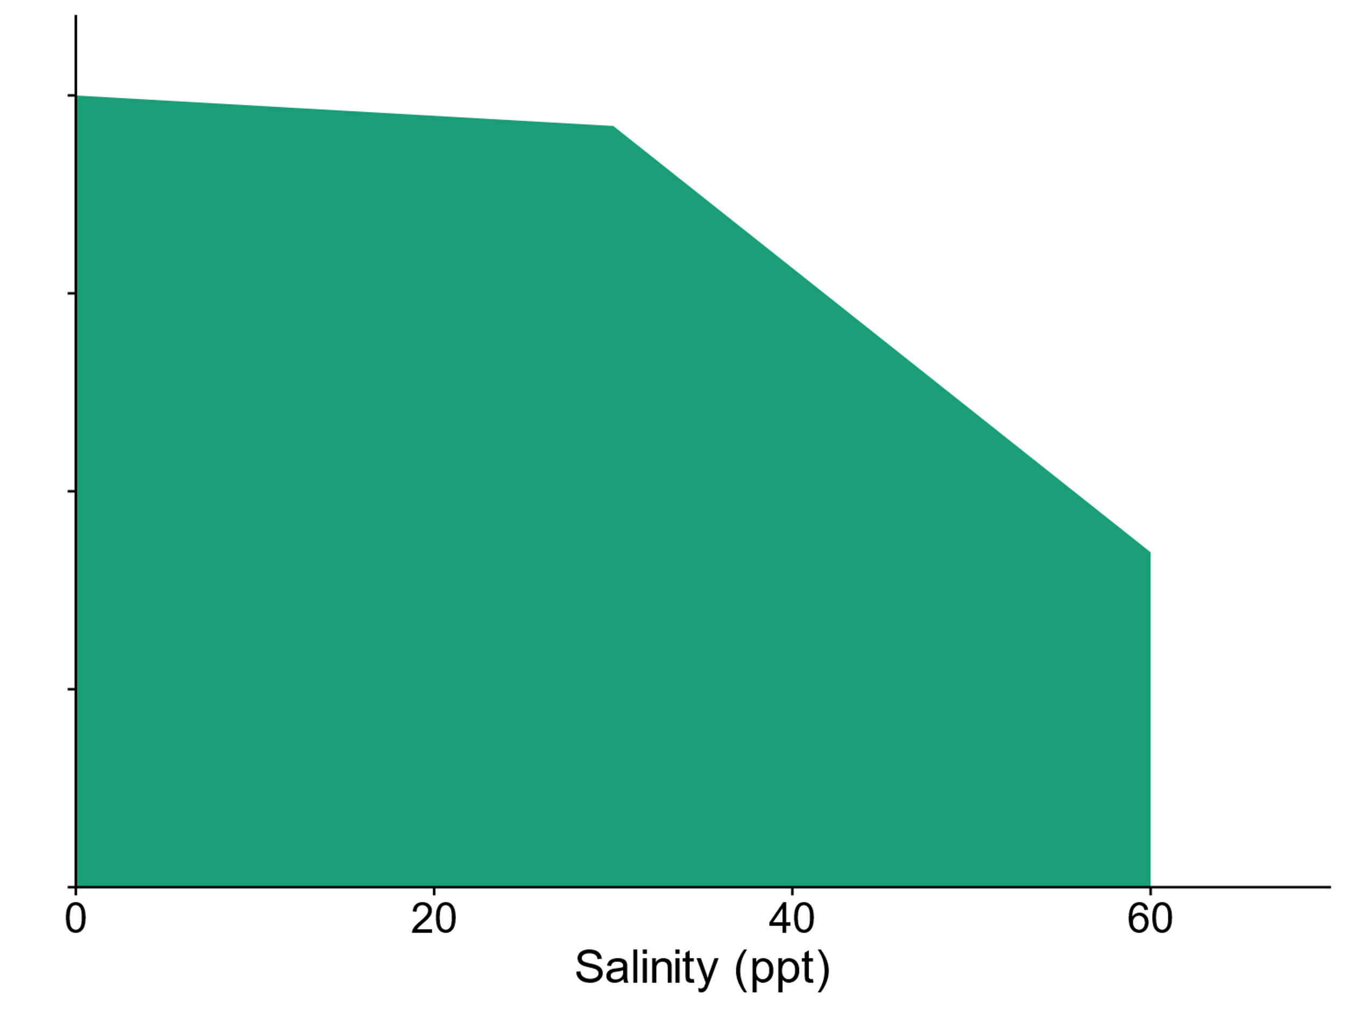
Is salinity tolerance discrete?
1. Sánchez-Baracaldo et. al. 2005
2. Uyeda et. al. 2016
3. Sánchez-Baracaldo et. al. 2017
High salt tolerance terrestrial reaction norm
Notes:
On the other hand, if we look at the maximum salinity at which growth was observed, a considerable number of strains can be found growing above 35 ppt. It is worth noting that the scale on the x-axis has changed from a maximum around 50 ppt to well over 200 ppt. Interestingly, several terrestrial strains have maximum salinities above that of the hypersaline strains for which we have data. And several marine strains have maximum salinities below those typically associated with marine environments.

Slide 23
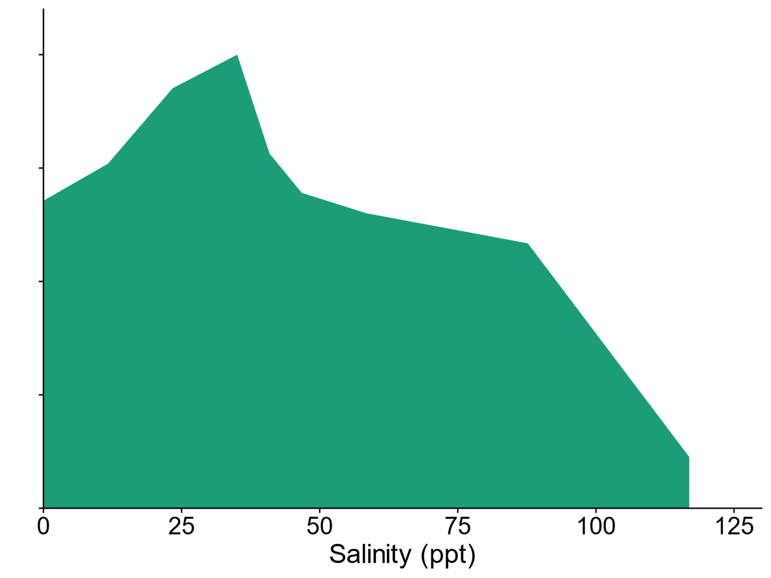
Is salinity tolerance discrete?
1. Sánchez-Baracaldo et. al. 2005
2. Uyeda et. al. 2016
3. Sánchez-Baracaldo et. al. 2017
High salt tolerance terrestrial reaction norm
Notes:
On the other hand, if we look at the maximum salinity at which growth was observed, a considerable number of strains can be found growing above 35 ppt. It is worth noting that the scale on the x-axis has changed from a maximum around 50 ppt to well over 200 ppt. Interestingly, several terrestrial strains have maximum salinities above that of the hypersaline strains for which we have data. And several marine strains have maximum salinities below those typically associated with marine environments.

Slide 24
Research answers
Does habitat predict salinity tolerance?

Slide 25
Research answers
Does habitat predict salinity tolerance?
Sometimes but not always

Slide 26
Research answers
Does habitat predict salinity tolerance?
Is salinity tolerance discrete?
Sometimes but not always

Slide 27
Research answers
Does habitat predict salinity tolerance?
Is salinity tolerance discrete?
Sometimes but not always
No

Slide 28
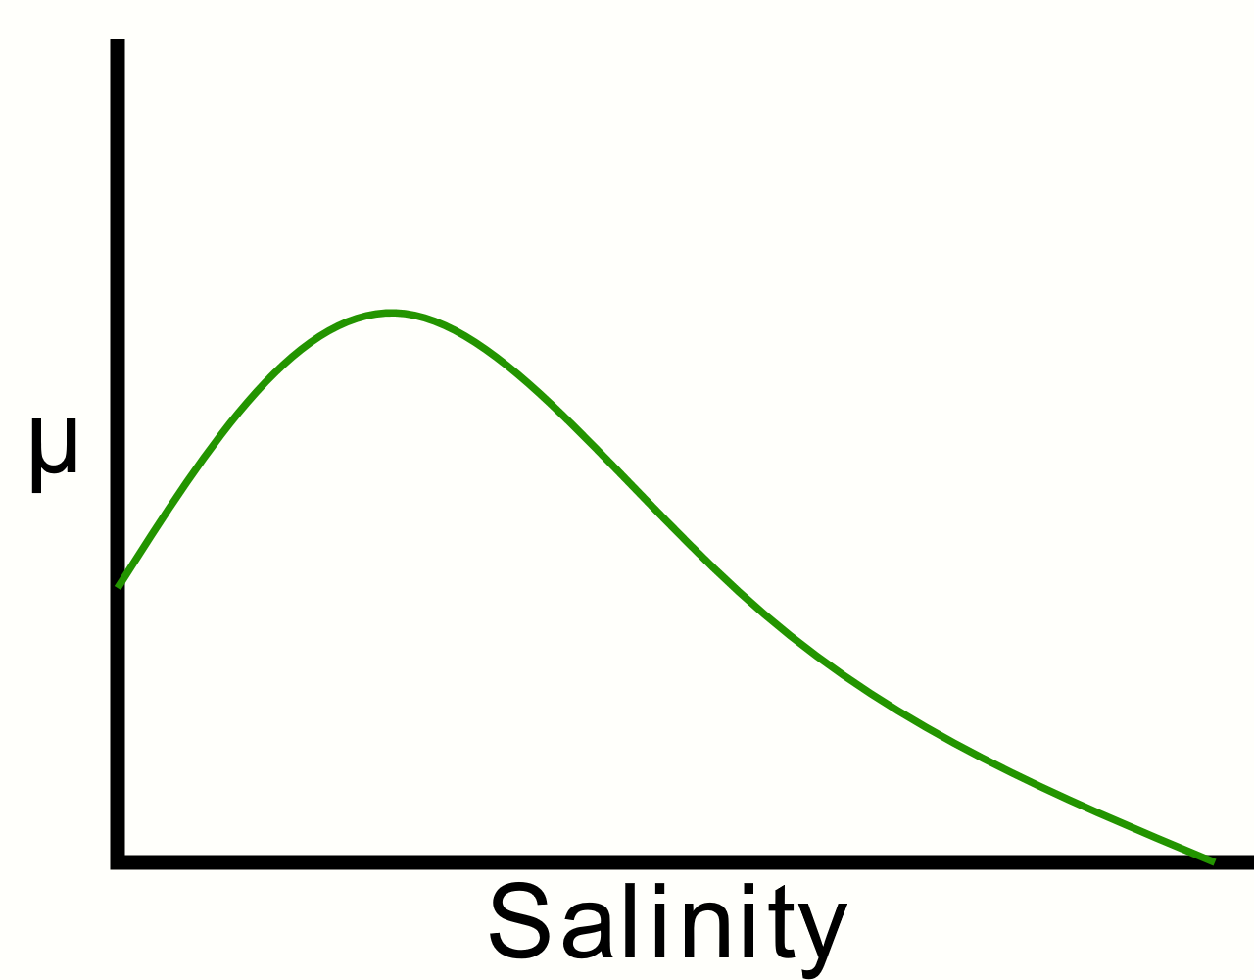
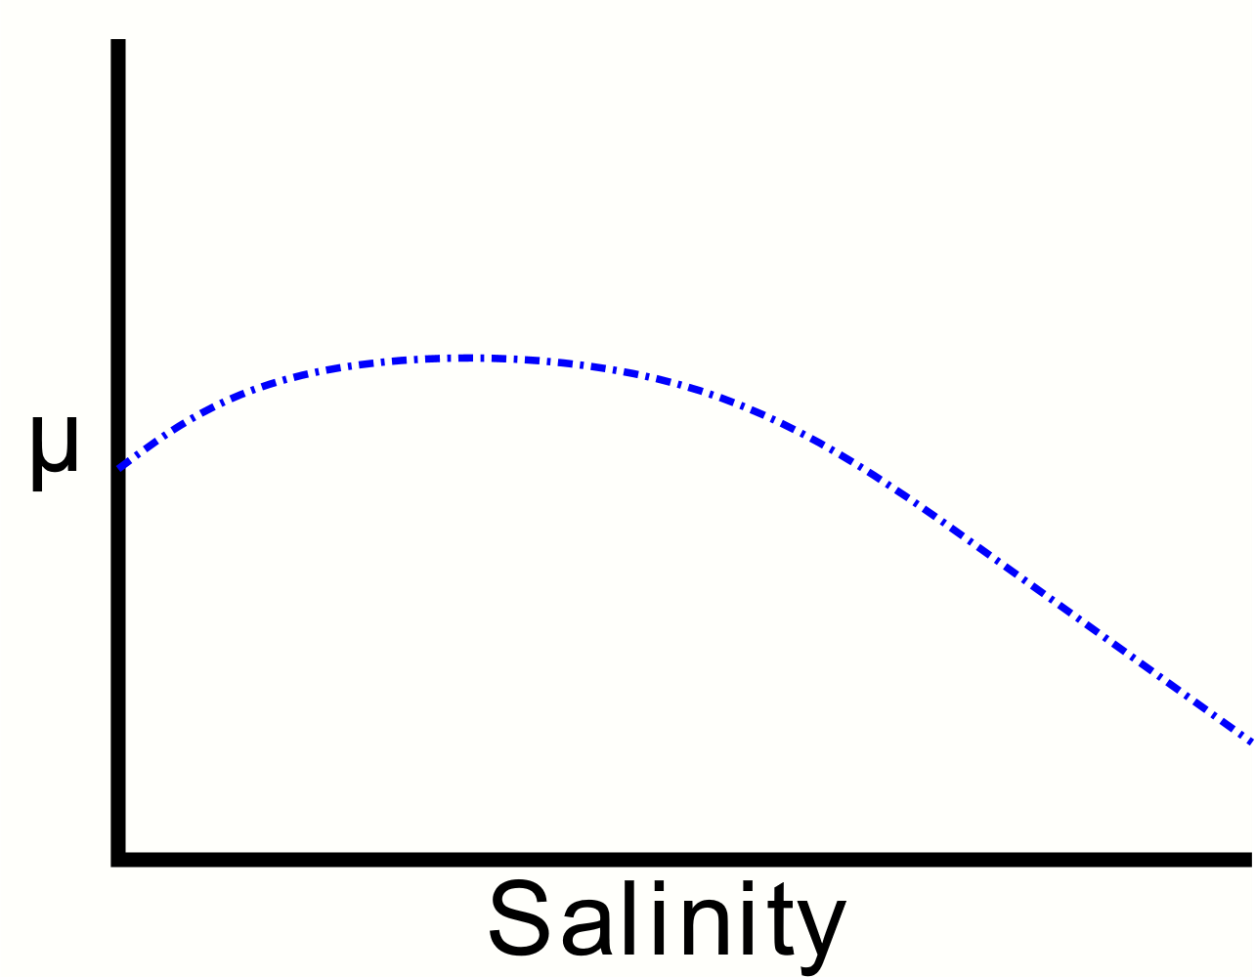
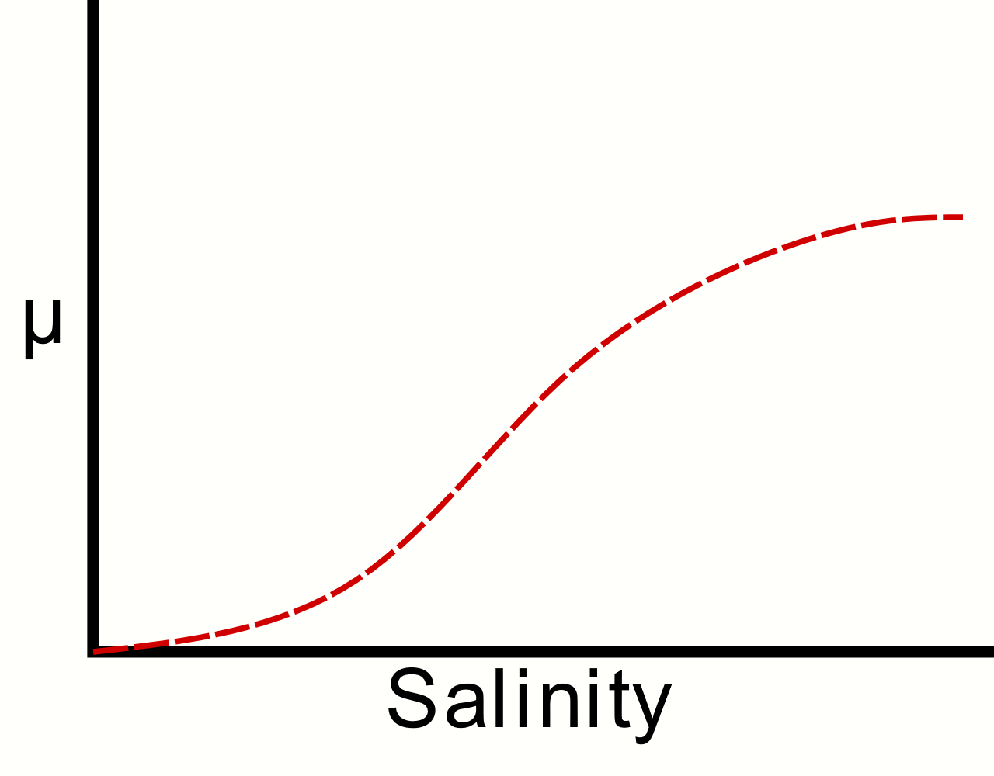
Future question: Can we identify molecular mechanisms behind the different response shapes?
Notes:
The first question we are working on addressing is can we identify mechanisms behind these different shapes of reaction norms and where the optima are in them?

Slide 29
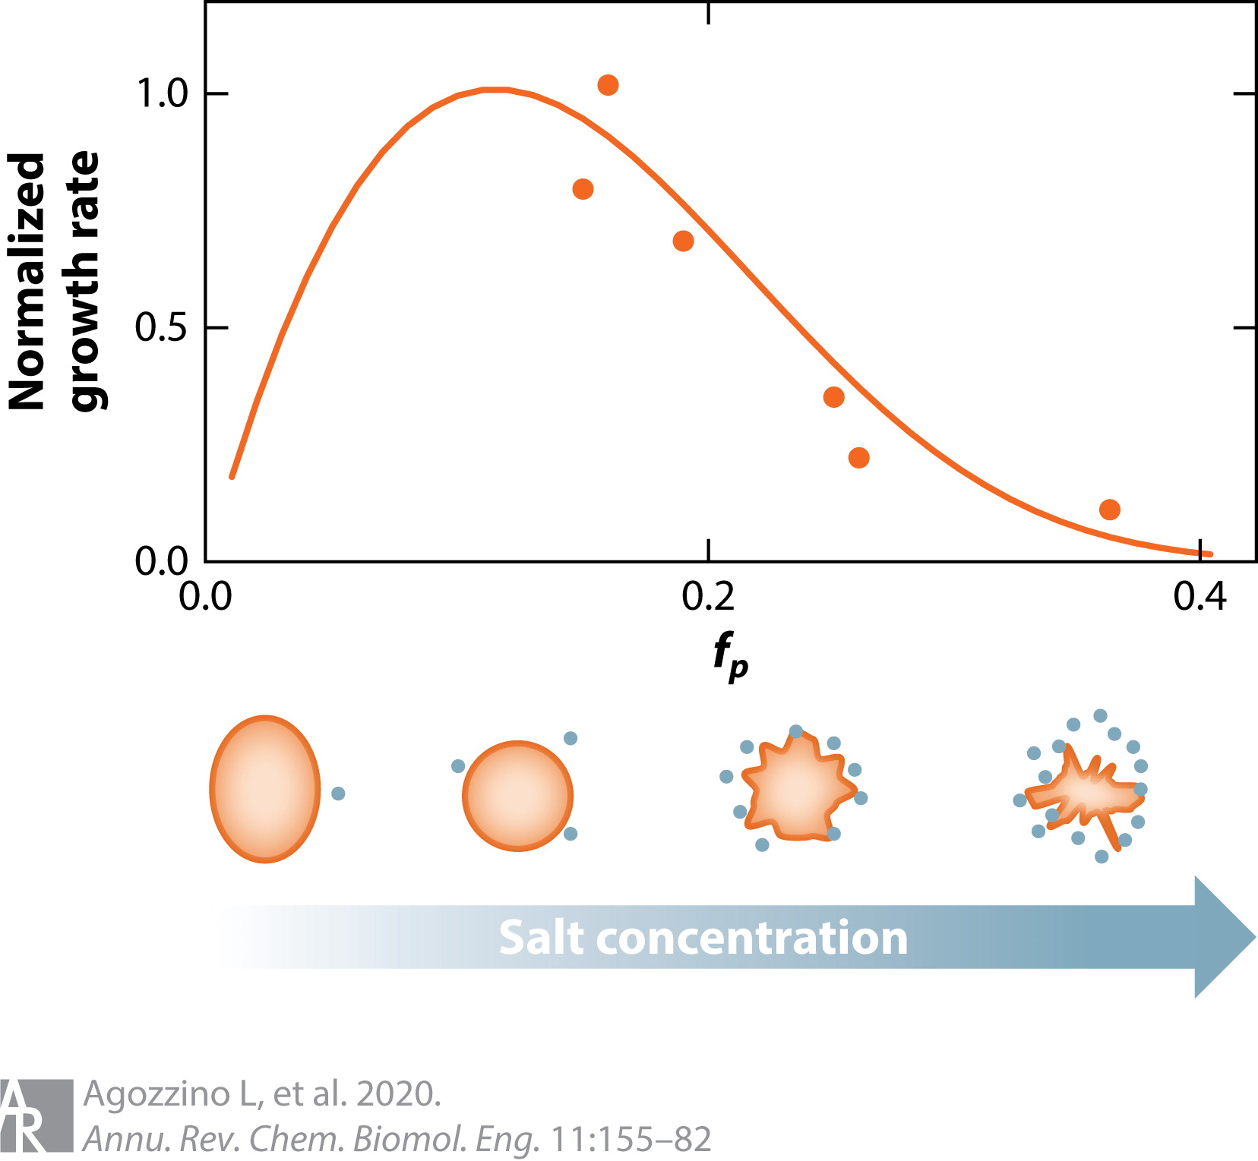
Future question: Can we identify molecular mechanisms behind the different response shapes?
Notes:
There are several mechanisms we are looking into, one of which is how cells change their size to maintain osmotic homeostasis.

Slide 30
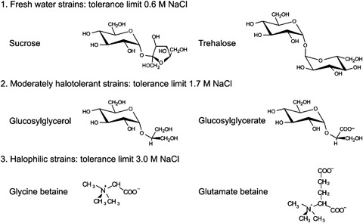
Future question: Can we identify molecular mechanisms behind the different response shapes?
Notes:
We are also looking at how different combinations of compatible solutes impact the reaction norms.

Slide 31

Future question: How do these reaction norms evolve?

Slide 32
Future question: How do these reaction norms evolve?
Ancestral state reconstruction

Slide 33
Future question: How do these reaction norms evolve?
Experimental evolution

Slide 34
Acknowledgements
Support:
CU Geobiology Community, especially my graduate student colleagues/friends
Co-authors
Adam Younkin
Friends and family
Funding:
University of Colorado Boulder Graduate School
Department of Geological Sciences, University of Colorado Boulder
Biological Sciences Initiative, University of Colorado Boulder

Slide 35

Questions?
Slides as PDF or PPTX available at: https://bit.ly/39Dk1Kc
Email: jennifer.reeve@colorado.edu • Twitter: @seejenscience

